Slide 1
Please take out a sheet of notebook paper and a pen.

Slide 2
First thing’s first…
About yesterday…

Slide 3
Bienvenue
=
Welcome

Slide 4

What is Humanities?

Slide 6
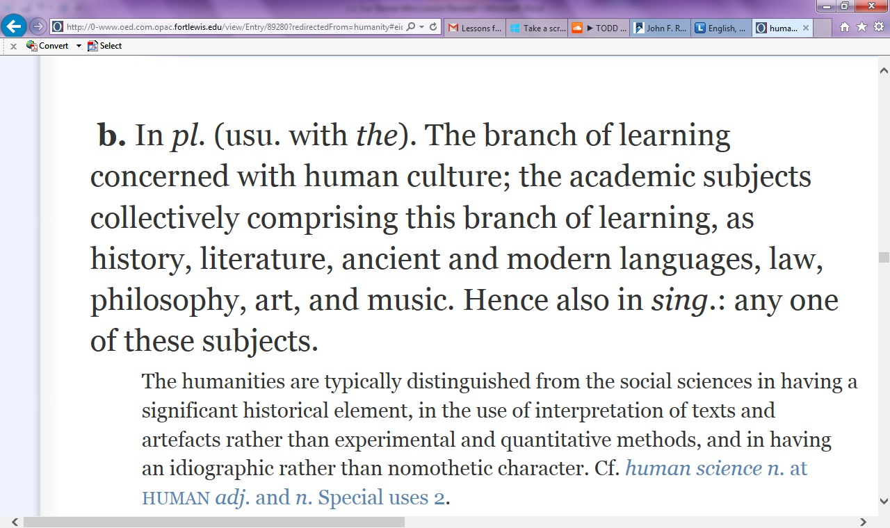

Slide 7
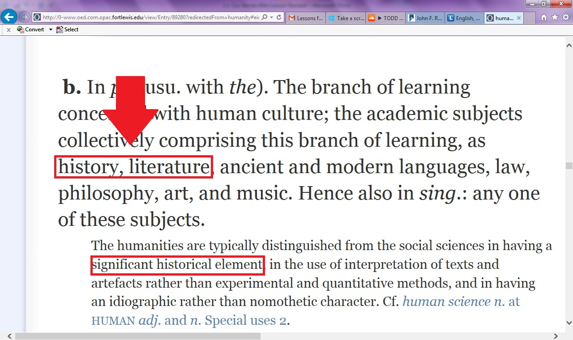

Slide 8

Sounds kind of boring…

Slide 9
The First Rule of Storytelling
DON’T BORE THE READER.
If it’s a farm outside of Kansas, I want to smell the freshly cut hay.
If it’s the Durango Skatepark, I want to smell the Red Bull and Cool Ranch Doritos.

Slide 10
Tell your partner a story from your summer vacation—what did you do? What happened to you?
  Setting!
  Characters!
  Beginning, Middle, End!

Slide 11
GO!

Slide 12
Tell your partner a story from your summer vacation—what did you do? What happened to you?
  -Setting!
  -Characters!
  -Beginning, Middle, End!

Slide 13
The Second Rule of Storytelling
Listen—
intentionally and intelligently. Listening is half the battle.
Show us that your listening.

Slide 14
The First Rule of History
Evidence,
Evidence,
Evidence!

Slide 15
In 3-5 sentences, summarize your story.
Then, list or draw the evidence you would need to prove you did what you said you did.

Slide 16
Brainstorm with your table.
1) List three elements unique to Storytelling.
2) List three elements unique to History.
3) List three elements that overlap between History and Storytelling.
4) List, or check similar items, on the Venn Diagram.

Slide 17
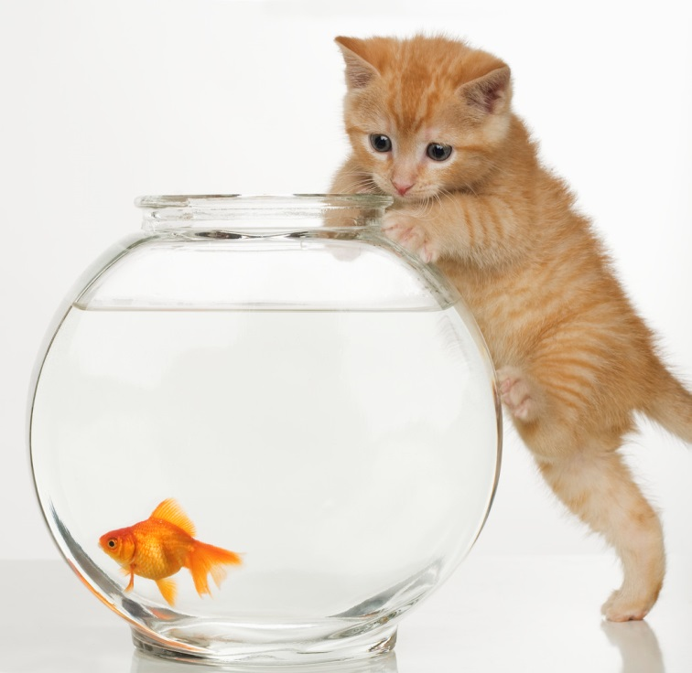
Why do we care?

Slide 18

We aim to explore human culture.

Slide 19
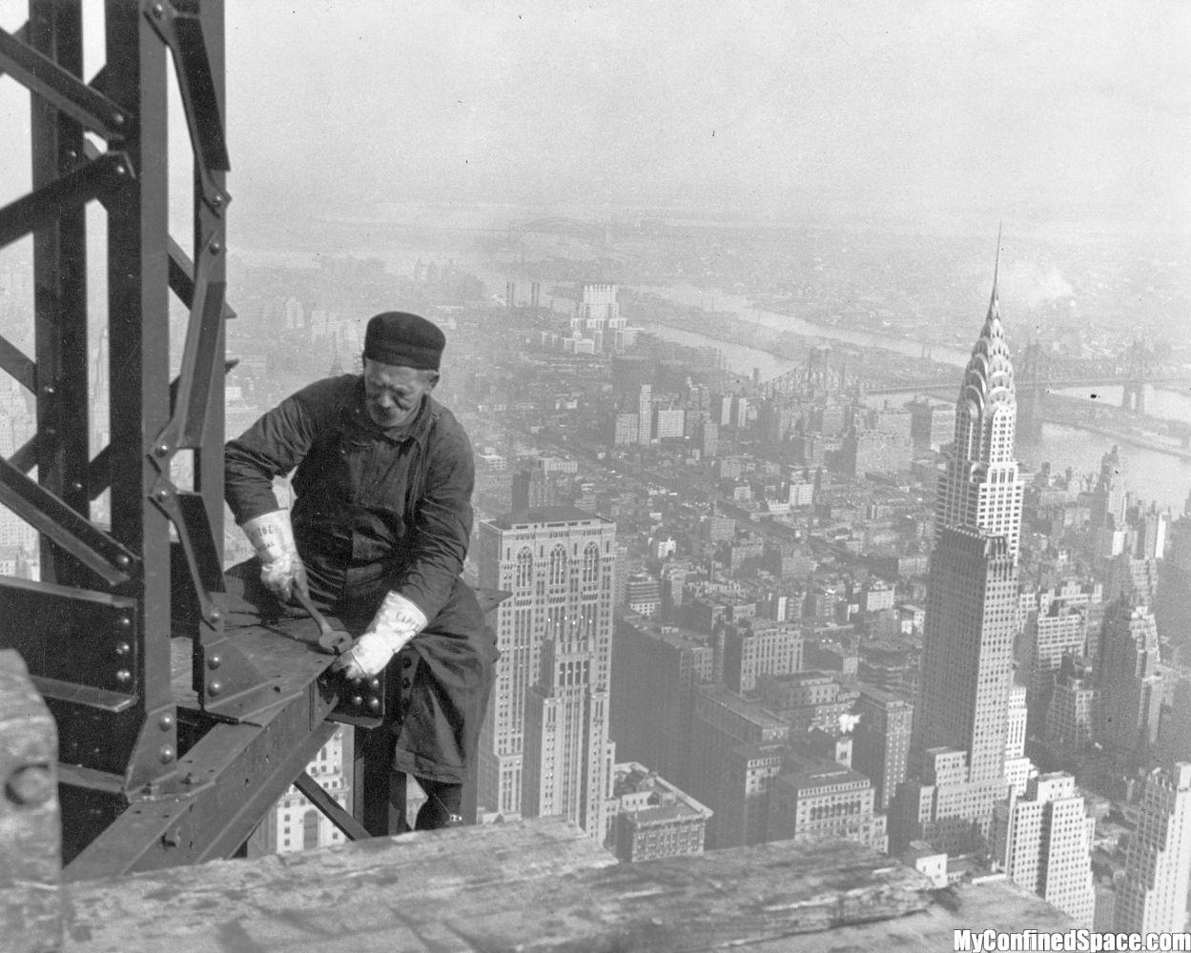
Toolkit

Slide 20


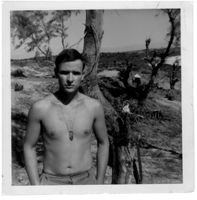
Imitating and Improvising

Slide 21
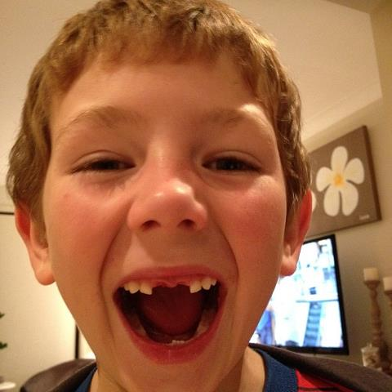

Slide 22

TRANSFORM!

Slide 23
What is Humanities?
-The study of us—our stories, our history.
-What will your story tell about you this year?
-Your story has to be risky. The best stories are the ones where you might lose your life; ridiculed, belittled.
-Nobody writes a story about how to be safe.
-What are your goals for this year? Climax.

