Slide 1
Economic Context
Germany After WWI

Slide 2
German Woman, 1923

Slide 3
German Inflation: 1923
US Dollar German Mark
January 1, 1923 $1 9,000
June 1, 1923 $1 100,000
August 1, 1923 $1 4,620,000
November 1, 1923 $1 4,200,000,000,000

Slide 4
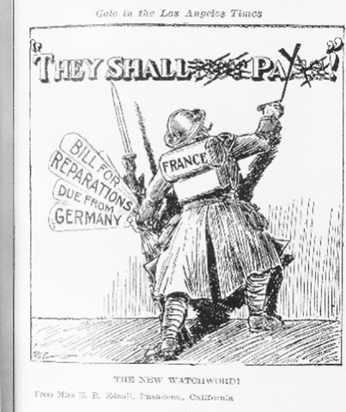
Why Inflation?
WWI Debt
Reparations + War Debt Interest = More than entire German GDP

Slide 5
Government Prints More Money

Slide 6
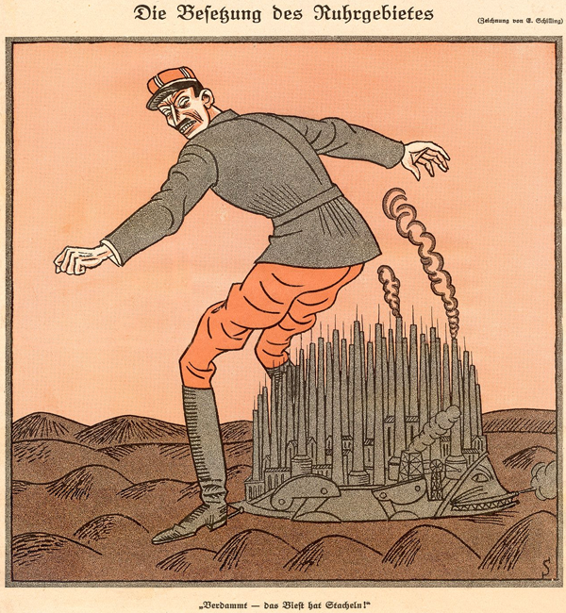
Can’t Pay? Now what?
“Beware of the dog, the beast has spikes!”

Slide 7
Hyperinflation Stopped By…
New currency
Fixed at 4.2 to the dollar
Backed by industrial and agricultural property
Reduced government spending

