Slide 1
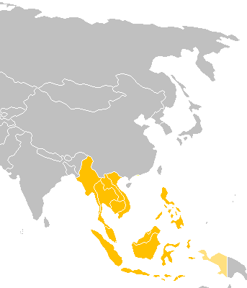
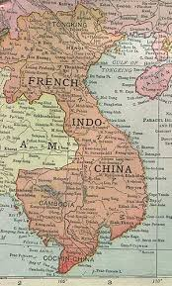
Back in Time…
Notes:
Review Surrounding Countries
Review Concept of Indochina
-French controlled Vietnam until the end of WWII
-Quickly overrun by Germans, Japan during WWII.
-After WWII, French are looking to assert their prowess again.

Slide 2
1945: Declaration of Independence

Slide 3
1946-1954: First Indochina War aka French Indochina War

Slide 4
1954: French Surrender/Geneva Accords

Slide 5
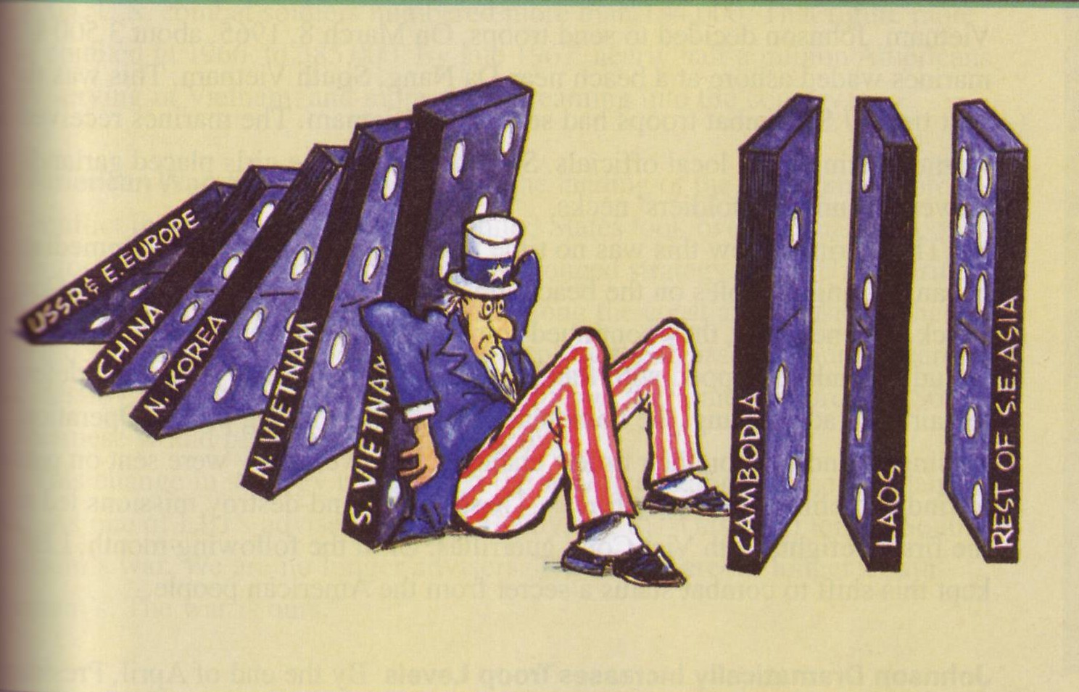

Slide 6
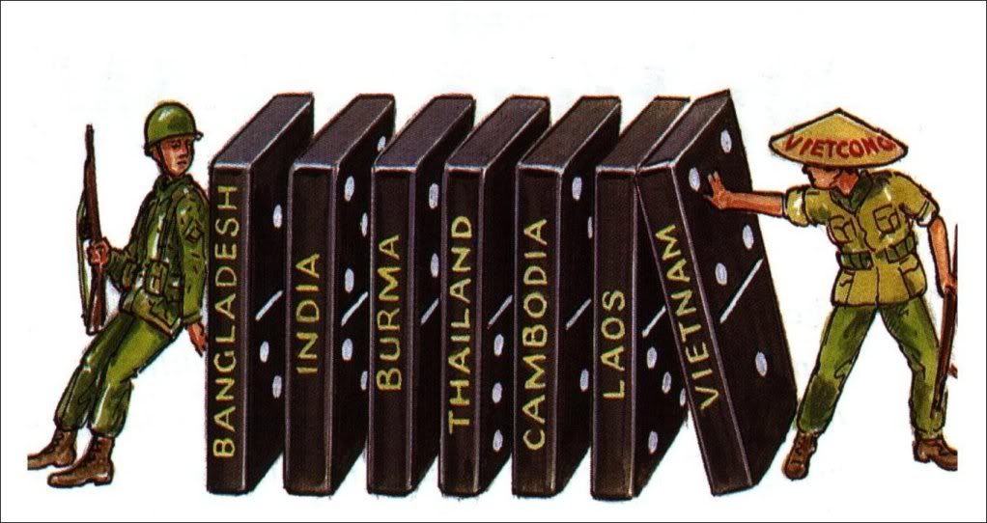
Domino Theory

Slide 7
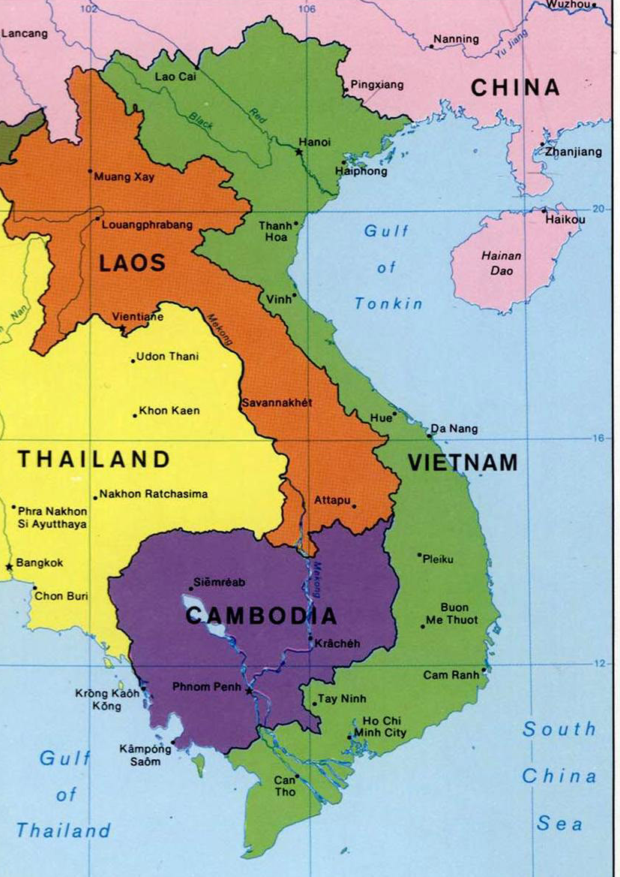
Notes:
Review Surrounding Countries
Review Concept of Indochina
-French controlled Vietnam until the end of WWII
-Quickly overrun by Germans/Japanese during WWII.
-After WWII, French are looking to assert their prowess again

Slide 8
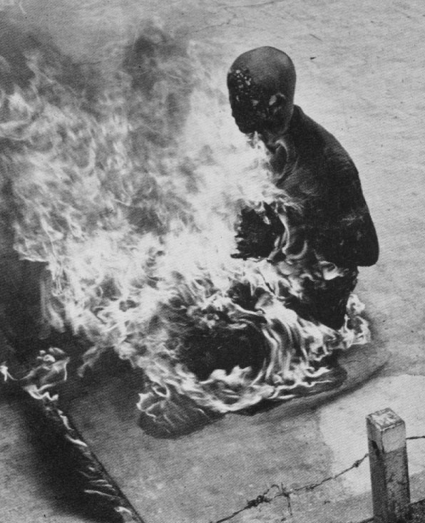
Origins of the War
Johnson was resolved to lose Vietnam to the communists
1961: Kennedy “loses” Laos and vows not to let another “domino fall”
Sends 16,000 troops to SVN (South Vietnam) by 1963
Further problems occur when the U.S. attempts to “relocate” SVN citizens to fortified villages and SVN President Diem represses riots and demonstrations with force
Now the U.S. is stuck with a SVN leader they once supported…but now loathe…
As a sign of protest against Diem’s government, Buddhist monks publicly burned themselves
The U.S. was determined not to let another one fall in SE Asia

Slide 9
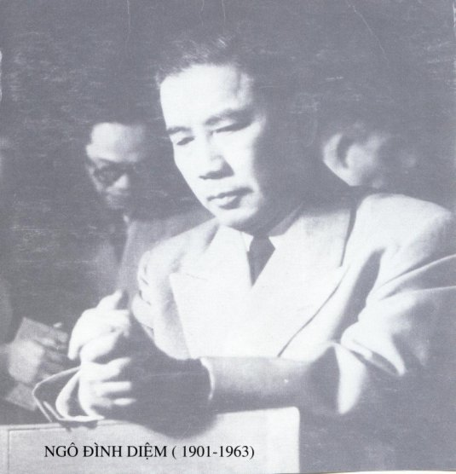
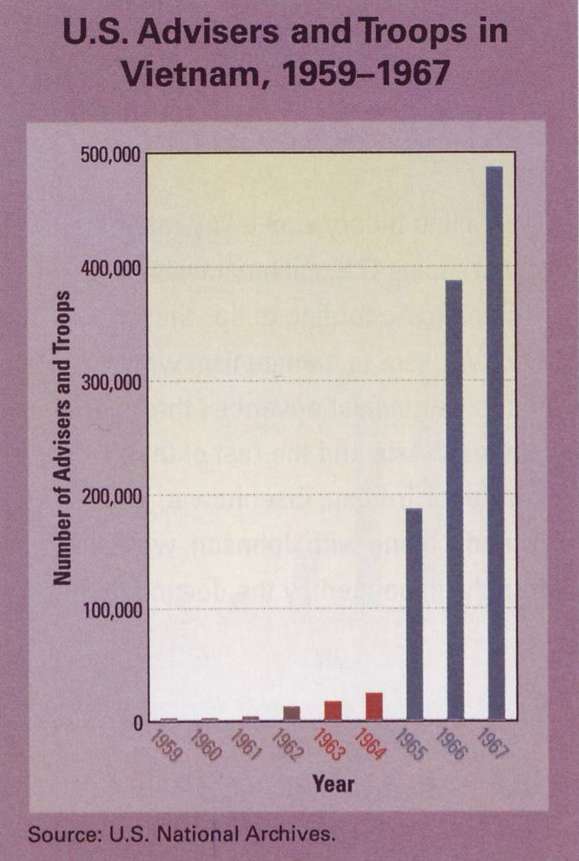
The Overthrow of Diem
Diem was avidly supported by the U.S. (he’s Catholic and anticommunist)
U.S. realizes that Diem isn’t strong enough to control the NVN Vietcong
November 1, 1963: Diem seized by SVN rebels and shot
Kennedy dies less than a month after Diem, so it remains unclear as to what Kennedy might have done with the new SVN gov’t…
U.S. sends a series of advisors to SVN to oversee the transition of the new government, and new Sec’ys of Defense and State take over where Kennedy left off
Ngo Dinh Diem went from bad to worse in 1963

Slide 10
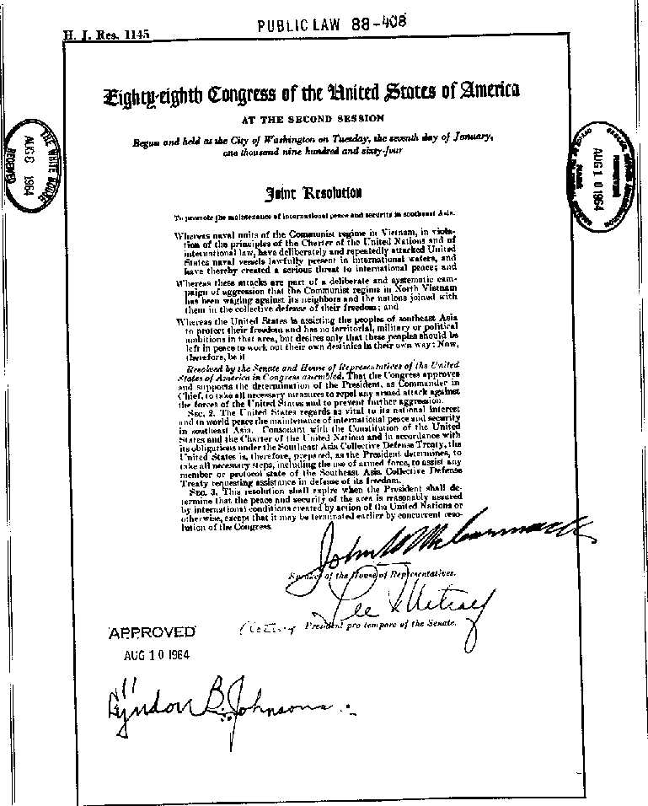
Tipping Point
August 1964: NVN patrol boats attack 2 U.S. destroyers in the Gulf of Tonkin
LBJ sees it as a deliberate attack…
In the Gulf of Tonkin Resolutions, Congress gives LBJ a “blank check” with which to do whatever he wants in Vietnam
This perceived misuse of power will be the beginning of his end
Early 1965: Operation Rolling Thunder delivers increased airstrikes on NVN
Serves only to increase the fervency of the NVN and the increased attacks and supply reinforcements via the Ho Chi Minh Trail
The Gulf of Tonkin Resolutions gave LBJ a “blank check”

Slide 11
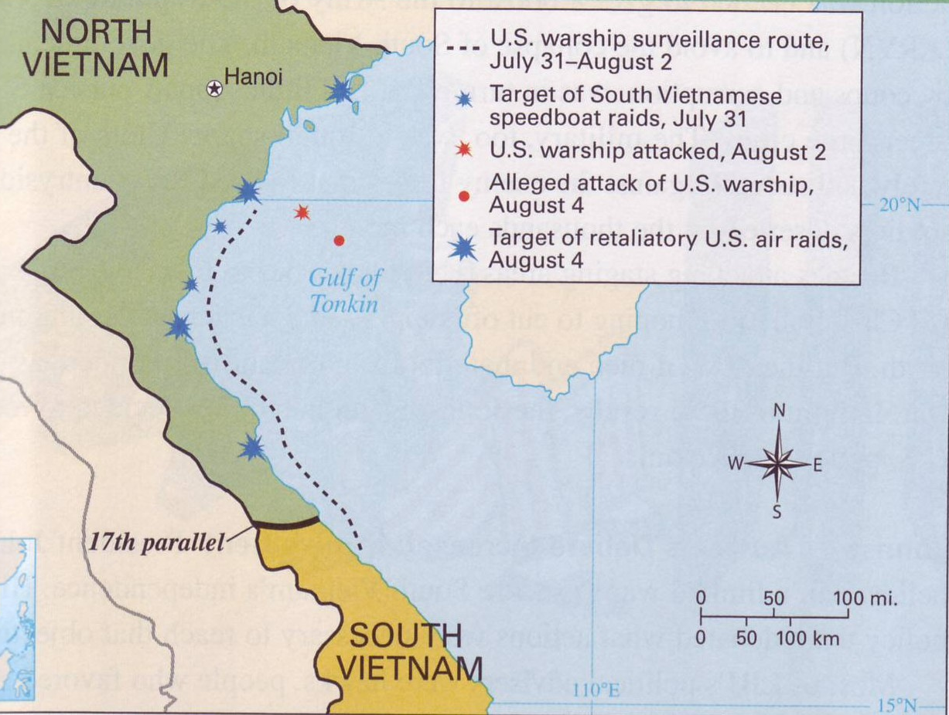

Slide 12
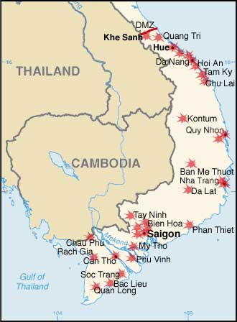
1968- Tet Offensive

