Slide 1
Causes of WWI
Imperialism

Slide 2
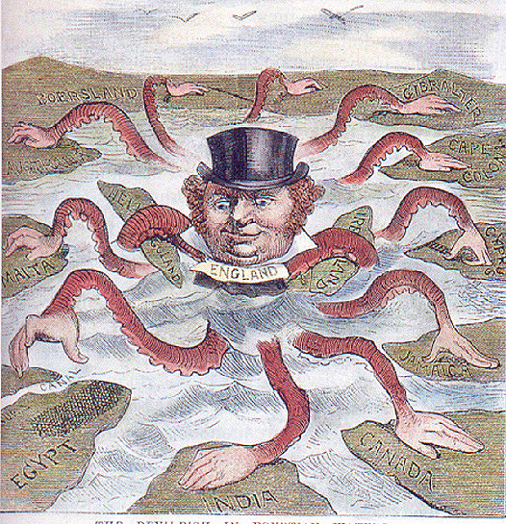
Starter #7: The Devilfish in Egyptian Waters

Slide 3
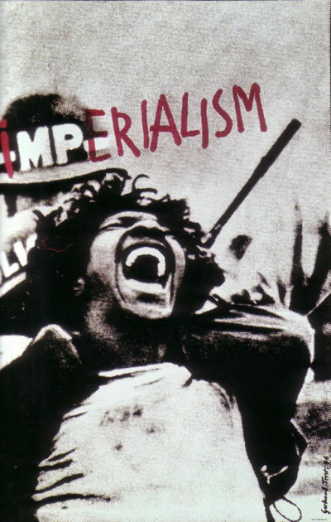
Imperialism
Creation or maintenance of:
Unequal economic and cultural relationship
Usually in form of an empire
One nation dominates other nations, often through force

Slide 4
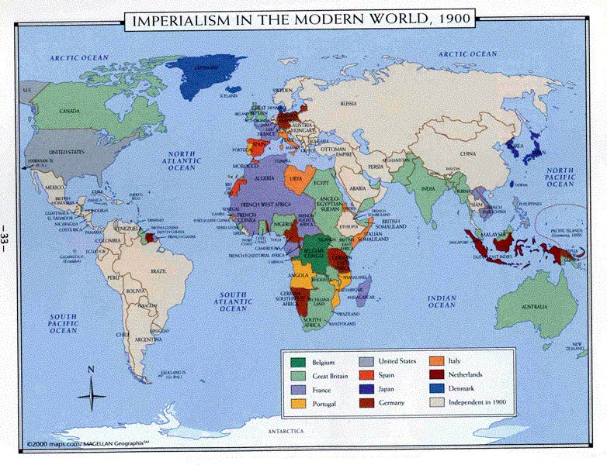
Where was Imperialism?

Slide 5
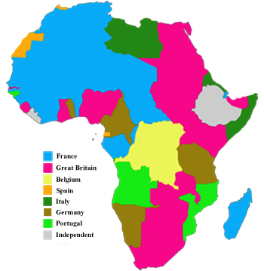
Berlin Conference
1884-1885
Meeting between 13 European nations
Split up Africa between them
By 1902, 90% of land in Africa under European control

Slide 6
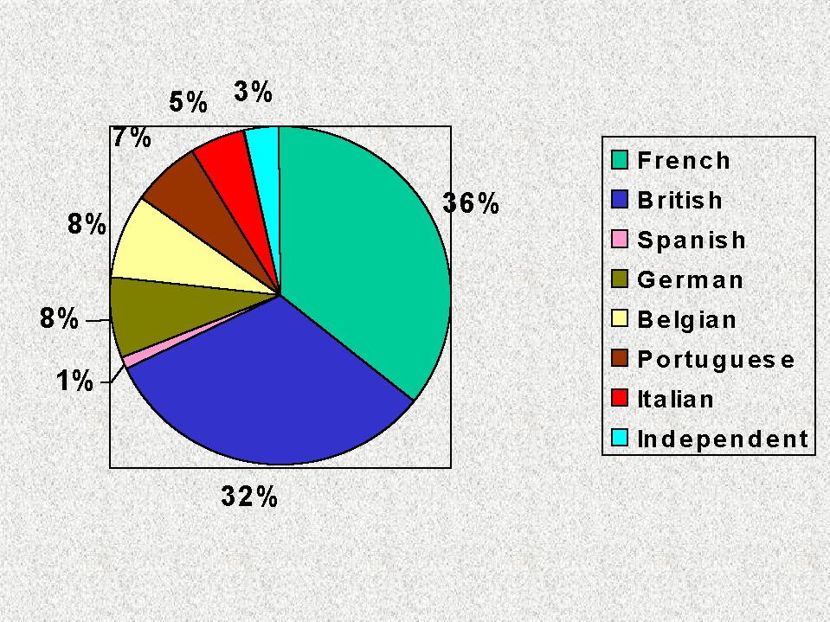
Division of Africa, 1902

Slide 7
The Big Question
In your notes, write an answer to the following question:
How did Imperialism help to cause WWI?
Make sure to include at least one specific example to support your position!

